Slide 1
Friday 31st January 2020
WALT: Emotional Regulation

Slide 2
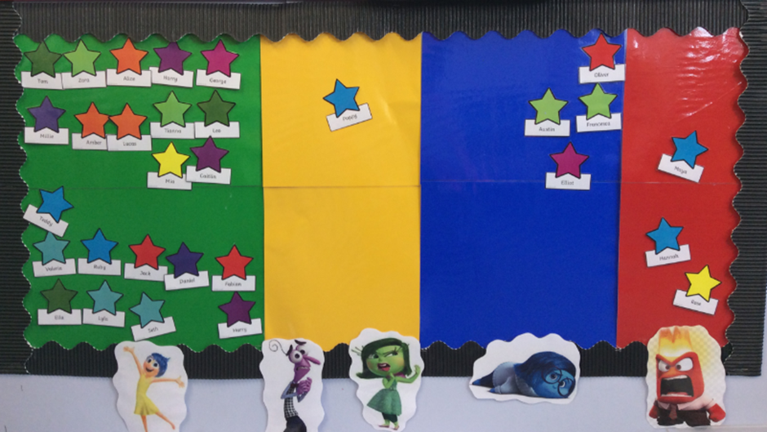
We all have these board in our rooms but what does each zone actually mean and how should we use this board effectively?

Slide 3
Happy Calm Ready to learn
Anxious Stressed Scared Still have some control Confused
Sad Tired Ill Bored
Out of control Angry Not able to focus.

Slide 4
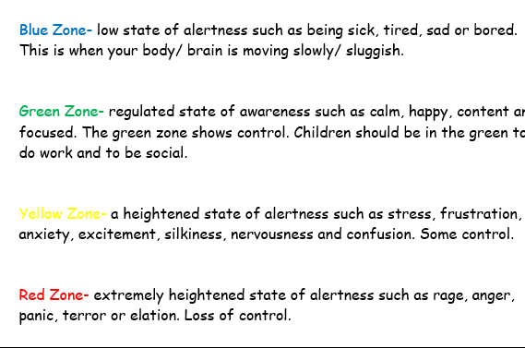

Slide 5


