Slide 1






Slide 2

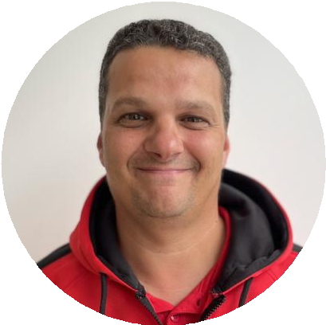
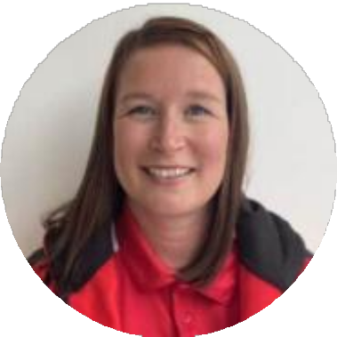
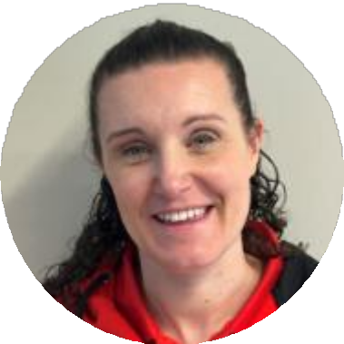
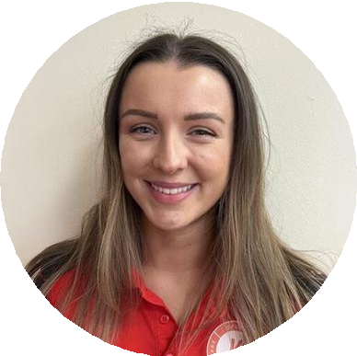











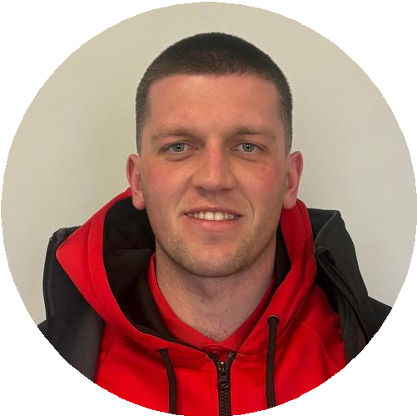
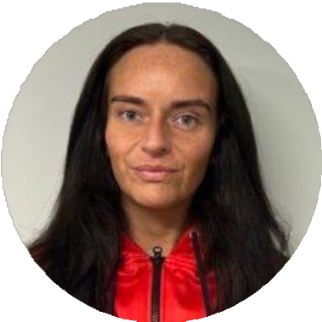











te^{T}a^{H}m^{E}

Slide 3

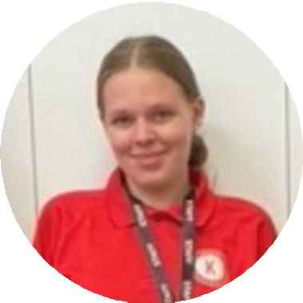
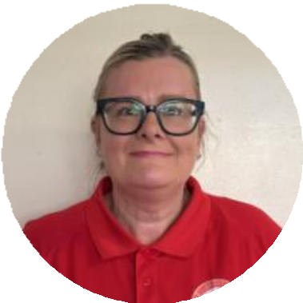
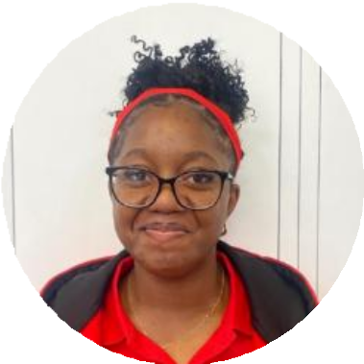






te^{T}a^{H}m^{E}

Slide 4



Set up in 2016
Strong reputation for quality
Experienced professionals
About Us
Community driven social engterprise
Family run business
In September 2026 we will be responsible for 12 Ofsted Registered Out of School Clubs across the region
Ofsted Registered and
Founders of the
National Out of School
Network

Slide 5



























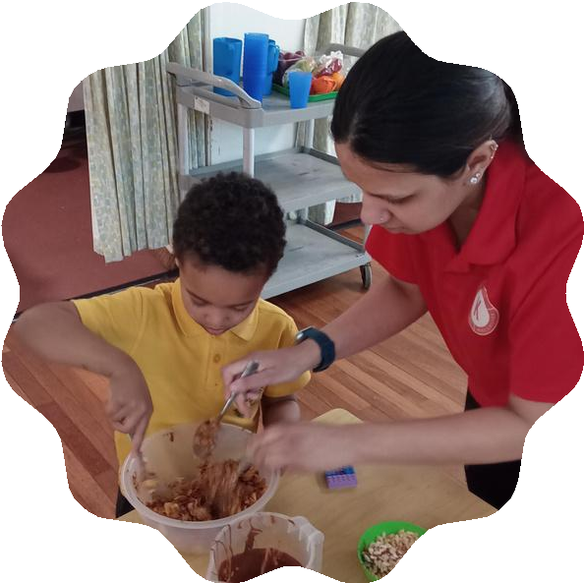





Where Every Child Matters
•
•
•
•

Slide 6


Slide 7


“The leadership team is relentless in pursuing excellence, building a highly successful and popular club in just two years through consistently high standards. This provision is a true asset, offering exemplary wraparound care for children and families”

Slide 8






CLUBS & DETAILS
Afterschool Club
•
•
•
•

Slide 9





CONTRACT BOOKING
Bookings
•
•
•
AD HOC BOOKING
•
•
•

Slide 10















Inclusion

Slide 11



BOOKINGS
How do
I book a place?
KEY DATES

Slide 12











Thank you
INSTAGRAM
FACEBOOK X LINKEDIN EMAIL CALL

