Slide 1
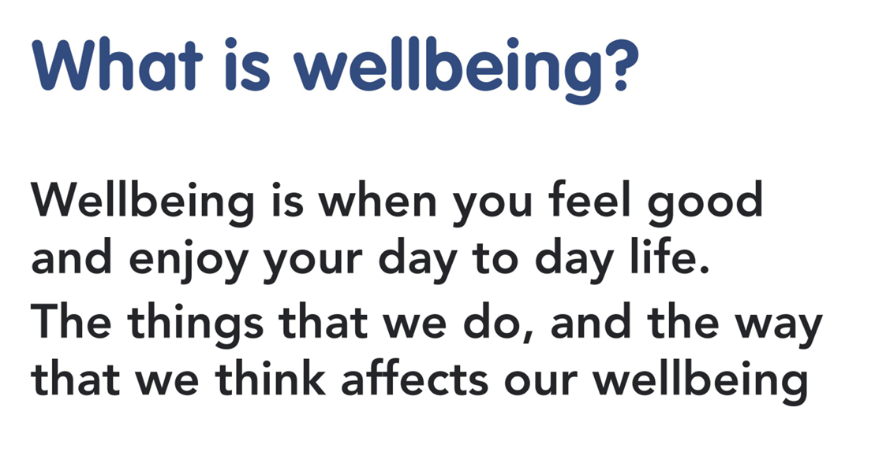

Slide 2
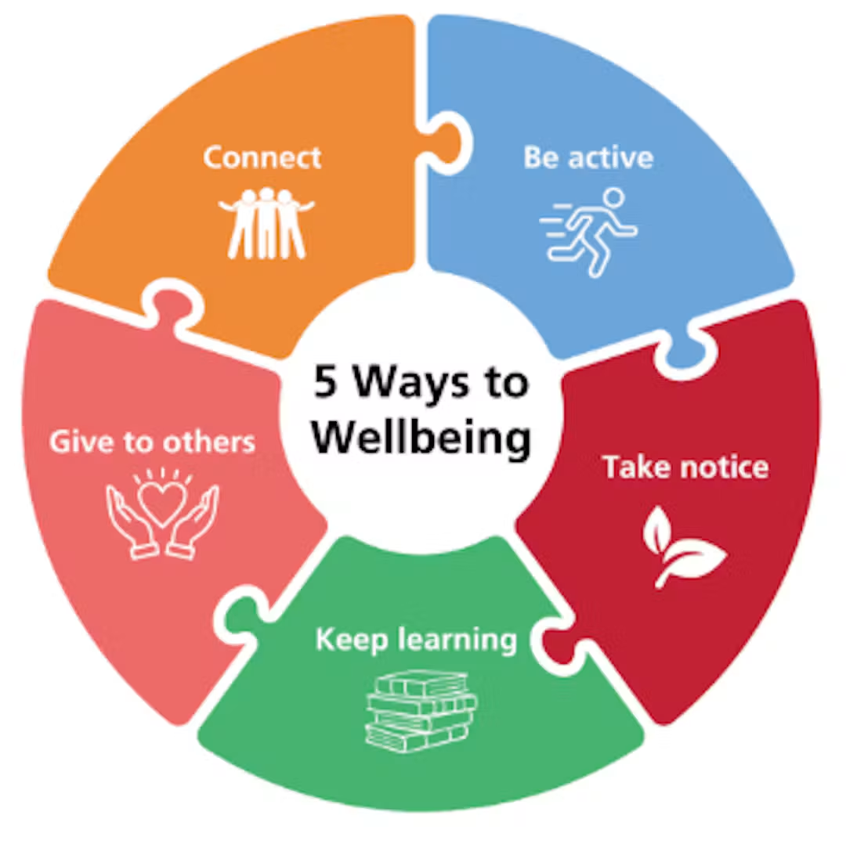
5 Ways to Wellbeing

Slide 3
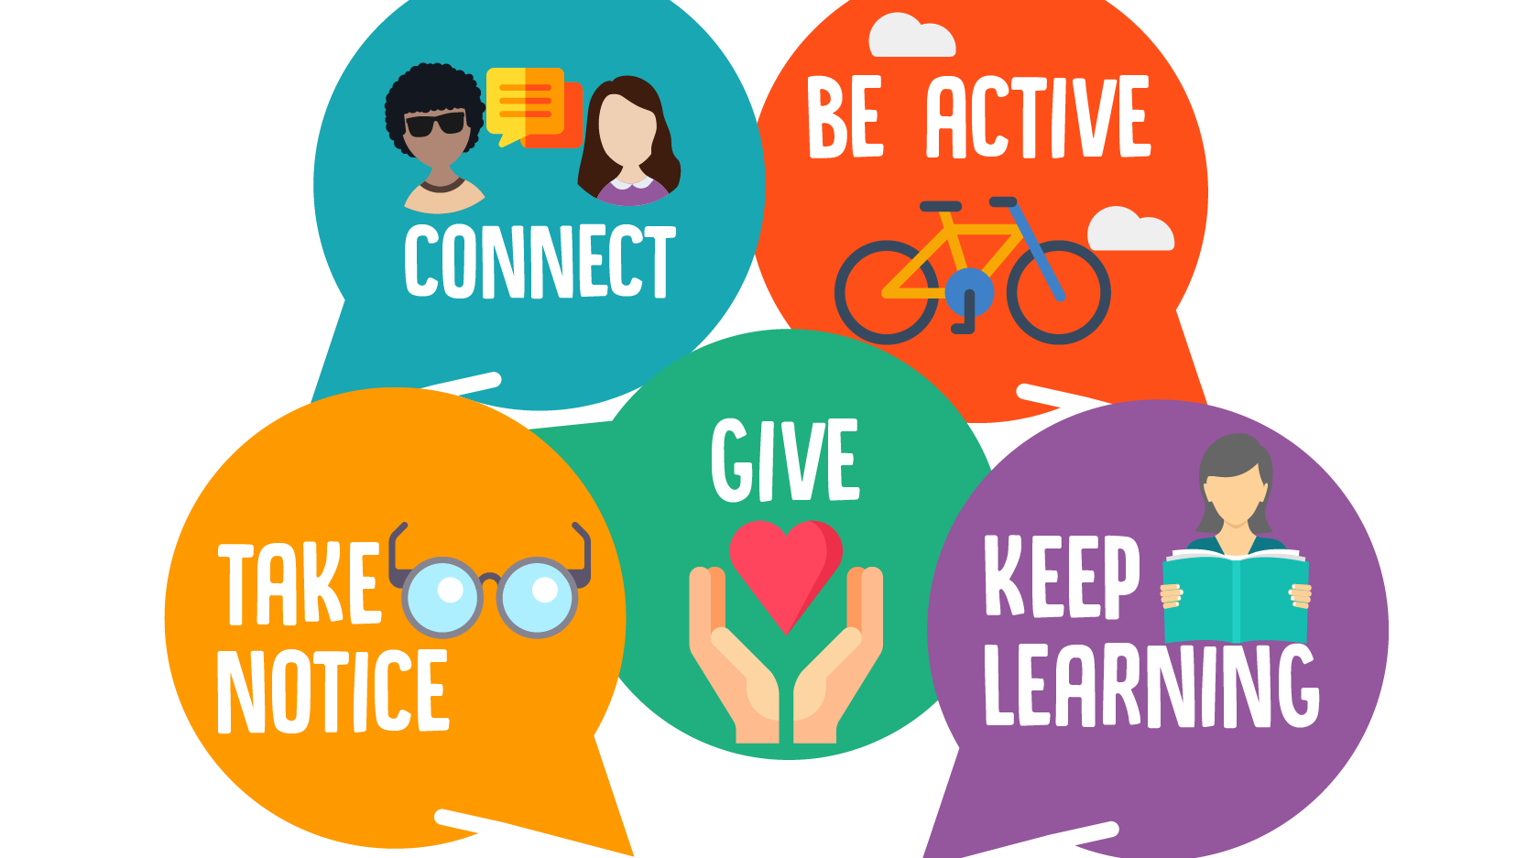

Slide 4


Autumn term 2

Slide 5
Connect (Build Relationships)
Talk and share stories with family members or friends during mealtime.
Play cooperative games, board games, or do a puzzle together.
Make a hand-drawn card or write a nice note for a grandparent, friend, or neighbour.
Say hello or smile at people in your school or community

Slide 6


Spring term 1

Slide 7
Be Active (Move Your Body)
Walk, scoot, or cycle to school instead of taking the car.
Have a living room dance-off, stretch, or practice kid-friendly yoga.
Play a game of tig, run races, or kick a ball around in a local park.
Try a fun home workout or active video challenge like Joe Wicks P.E.

Slide 8


Spring term 2

Slide 9
Give (Kindness and Generosity)
Help out around the house by tidying toys or setting the dinner table.
Donate toys or books you have outgrown to a local charity shop or school.
Give someone a big hug or offer a genuine compliment to a friend.
Listen carefully when a friend or sibling needs to talk about their day

Slide 10


Summer Term 1

Slide 11
Keep Learning (Explore and Grow)
Read a fun fiction book, comic, or magazine every day.
Bake a simple recipe or help make dinner and measure out the ingredients.
Learn a new joke, magic trick, or word in another language.
Build something using construction blocks, Lego, or junk-modeling craft materials

Slide 12


Summer term 2

Slide 13
3. Take Notice (Be Present and Curious)
Play "I spy" or look out the window to watch birds, clouds, or trees.
Go on a nature walk and collect interesting leaves, pebbles, or pinecones.
Name 5 things you can see, 4 you can touch, 3 you can hear, 2 you can smell, and 1 you can taste.
Notice your breathing and learn some tools to regulate your breath (eg box breathing)

Slide 14


